Slide 1

Differentiation
An OVERVIEW
“If a man does not keep pace with his companions, perhaps it is because he hears a different drummer.” Henry David Thoreau

Slide 2
Session objectives
To clarify what the term differentiation means
To develop an understanding of why it is central to 21st teaching and learning
To identify the different criteria we use to differentiate

Slide 3
What does it mean?
According to the Training and Development Agency for Schools, 'differentiation' is the process by which differences between pupils are accommodated so that all students have the best possible chance of learning.
TES magazine Dec 13
Notes:
Before bringing up the definition allow ppts to write their own definitions. Definition comes up on click

Slide 4
Why is it an essential element of 21st century teaching and learning?
We now know that the way in which children learn differs in many different ways
Children think in different ways and their emotional response varies
Children have varying levels of motivation
We have an increased awareness that seeing & knowing our learners as individuals is important
It is no longer simply a question of providing a task which “differentiates by outcome” ie: one which allows learners to progress as far as their ability allows them
We now put the learners rather than the teacher at the centre of the classroom
Notes:
Again, allow time for ppts to think of the reasons themselves before showing the points one by one. The next slide will show the rationale of Differentiation guru Carol Tomlinson

Slide 5
If we know that our learners differ in terms of level, learning style and motivation…….…………….
Carol Ann Tomlinson ERIC EC Digest 1995
Notes:
Ask ppts to complete the sentence

Slide 6
……..how can we justify a one size fits all model of teaching?

Slide 7
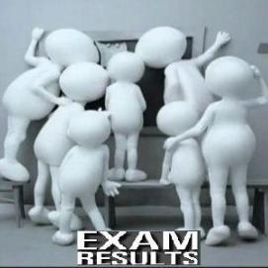
Differentiation criteria
1. Level of language proficiency
For many teachers this is as far as Differentiation goes
Their assessment of the learner’s ability is based on summative/formative tests & their own ongoing perceptions
Notes:
Before bringing up this slide try to elicit the basis upon which teachers generally differentiate in their lessons. It is likely that language level will be the overriding criteria because this is what they can witness and measure. Try to elicit what strategies are used for this kind of differentiation

Slide 8
How do teachers manage mixed ability classes?
Give different students different material & activities according to ability
Group students according to ability so that stronger students work on different content to weaker students
Give learners different roles in groups according to ability
Pair students so that stronger students “teach” weaker students
Design activities which have extension tasks for stronger students
Give all students the same task but accept that some will get further with it than others
Have a bank of extra tasks available for stronger learners.
Notes:
Again, give ppts chance to note down in groups how they differentiate their lessons in terms of language ability

Slide 9
But (there is always a but….)
…..A class is not differentiated when assignments are the same for all learners and the adjustments consist of varying the level of difficulty of questions…,grading some students harder than others, or letting students who finish early play games……Asking students to do more inevitably seems punitive to them.
Carol Ann Tomlinson ERIC EC Digest 1995

Slide 10




Differentiation criteria
3: Learning styles

Slide 11
Auditory
Visual
Tactile
Kinesthetic

Slide 12
What kind of learner are YOU?
Take a few minutes to complete the questionnaire and discover your learning styles
Is the result what you expected?
How aware are you of your learners’ learning styles? How would you find out? Discuss in groups of 3.
Notes:
Nowadays we focus on only 3 styles and use the acronym VAK (kinesthetic incorporates tactile). Lots of online questionnaires. HO eg from Brainbox

Slide 13
Notes:
EG of online learning styles Q’aire

Slide 14
Differentiation criteria
3. Multiple Intelligences
Intelligence | Characteristics
1.Verbal- Linguistic | a. Enjoys drawing, colour, movies, books with pictures, maps
2. Spatial | b. Likes being outdoors, enjoys animals and plants, likes to classify and group things around her
3. Musical | c. Likes to move, enjoys doing rather than watching, well- coordinated
4. Logical- mathematical | d. Has a good sense of rhythm, enjoys music, sensitive to sounds
5. Interpersonal | e. Likes being & working with people. Lots of friends, good leader
6. Bodily-kinesthetic | f. Likes numbers and computers, enjoys problem solving, working with data
7. Intrapersonal | g. Likes to read and write, likes playing wit words, strong vocabulary
8. Naturalist | h. Prefers to work alone,strong sense of fairness, very self aware
Howard Gardner 1990s
Notes:
PPTs may well ask what the difference is between this and Learning Style & it’s not easy to answer. It seems that MI relates more to personality type and LS can be influenced by environmental factors BUT there is clear overlap. Ask ppts to match Intelligence & characteristics: 1 = g, 2= a, 3 = d, 4= f, 5=e, 6= c, 7=h, 8=b

Slide 15



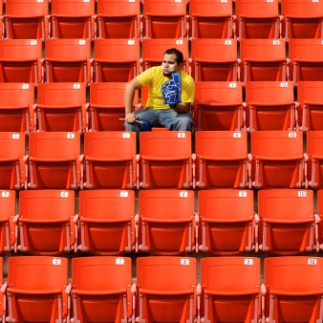
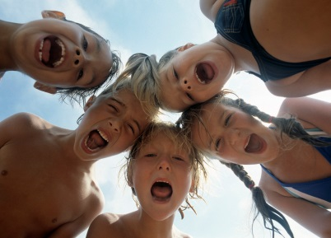



How are you smart???
Complete the questionnaire to find out about your own type of intelligence.
Look at the kinds of activities (on the back of the sheet) which suit the different types.
Notes:
HO: photocopies (double sided) of HOW I AM SMART

Slide 16


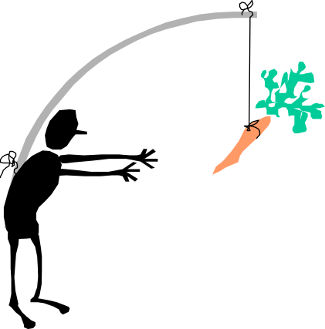
Differentiation criteria
4. Motivation
What are the 2 basic types of motivation?
INTRINSIC & EXTRINSIC
What are the characteristics of the 2 different types?
William Glasser 1998
Notes:
Answer: Intrinsic= likes to work cooperatively, participates in all types of activity, enjoys fun activities and games, enjoys the subject itself. Extrinsic= responds to rote learning, prefers T-centred lessons, doesn’t need variety, responds to reward systems

Slide 17
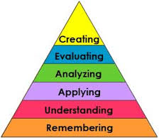
… and as if that isn’t enough..
Differentiation criteria
5. BLOOM & THINKING SKILLS
Notes:
Before showing the visual, ask the ppts to identify the different thinking skills and see if they can create the hierarchy. This is the revised version of the taxonomy (Lori Anderson), in which Creating rather than synthesis is at the top . HO: The cut up of the labels for them to build in pairs

Slide 18
Why is it important for all teachers to share the responsibility of developing their learners’ thinking skills?
Bloom’s taxonomy remains a user- friendly, familiar ----1.-----that can help teachers of all grade levels and ----2.----areas to ask questions and design tasks that engage critical thinking and appropriately ----3.----students. When used consistently, the taxonomy can help students make “a quantum leap to ----4.----order thinking”.

Slide 19
Bloom’s taxonomy remains a user- friendly, familiar model that can help teachers of all grade levels and subject areas to ask questions and design tasks that engage critical thinking and appropriately challenge students. When used consistently, the taxonomy can help students make “a quantum leap to higher order thinking”.
(Sousa 2001)

Slide 20
So, what does all this mean for the already overworked teacher and lesson planning??
To be continued.

