Slide 1

The Differentiation Deviser
80 ways to differentiate, for use across the curriculum and the Key Stages.
Made by Mike Gershon – mikegershon@hotmail.com – with thanks to Ruth Sandler and www.geoffpetty.com

Slide 2
The Differentiation Deviser
Keywords Simple Language Keyword Display Images Keyword Discussion
Exemplify Keyword Context Antonyms Modelling Conversation New Words
Dictionary Champions Task Explanation Seating Plans Hot-Seating Students Teaching
Envoys Socratic Dialogue Confidence Indicators Expert Corner Helpers
Model Answers Photocopy Good Work By Outcome Open Activities Prior Knowledge
Stepped Activities Options Choices Extensions Wonder Wall
Group Work Pair Work Discussion Personal Experience Pace Yourself
Card Sorts Match Group Rank Buzz Groups Design Brief Worksheets
Visits and Visitors Student Presentations Case Studies Discovery Learning Experiments
Question Range Question Planning Justify Open and Closed Clarification
Challenging Questions Students Ask Questions Serial Questioning Thinking Time Individual Questioning
Assertive Questioning Task Mixture Task Mixture II Blooming Extensions Evaluate and Create
Blooming Questions Top Middle and Bottom AFL Listening Frame Modelling
Check Sheets Structure Guidelines Sentence Starters Writing Frame Planning Pro-Forma
Scrap Paper Bullet Points and Tables Individual Writing Challenge Different Media
Activity Stations Narrative Peer Research Talk To Me Humour
Made by Mike Gershon – mikegershon@hotmail.com

Slide 3

Keywords
Back to
the start
Language is integral to learning. Keywords are those words which are central to the topic you are teaching. Differentiate by:
Providing students with a glossary of key words.
Providing a list of key words and definitions which will be appropriate for the lesson.
Providing a list of key words and examples of how to use them in a sentence.

Slide 4
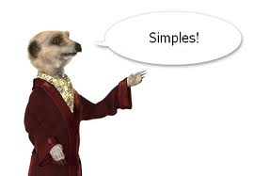
Simple Language
Back to
the start
The more complex the language you use, the less likely all your students will be able to access the meaning.
Differentiate by simplifying your language.
Consider the different places you might do this:
When speaking to the whole class.
When speaking to individuals
When writing comments.
On PowerPoint or IWB slides.
On hand-outs.
Simplifying does not mean dumbing down. It means making things clear and easy to understand.

Slide 5
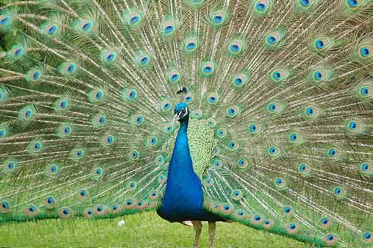
Keyword Display
Back to
the start
A good way to help students get to grips with keywords is to display them in your room. Here are five ways you might do this:
A list of keywords and definitions.
Keywords accompanied by relevant images.
Sentences in which the key words are being used.
Key words in a table with synonyms and antonyms.
Get your class to make collages or posters of keywords and display these.

Slide 6
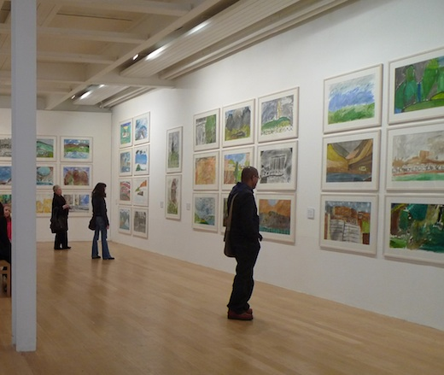
Images
Back to
the start
Images which connect to the words being used help all students to access the work.
You will notice that in this PowerPoint there is an image on every slide which connects to the strategy or technique.
Differentiate by including relevant images on any resources you make.
Use Google image search to find images quickly.
A further advantage of images is that they limit how much text you can include (and too much text is usually detrimental).

Slide 7

Keyword Discussion
Back to
the start
Before you ask students to use new keywords in their writing, encourage them to use them in discussion.
This will give students an opportunity to come to terms with the meaning of the keywords and how they can be used.
Mistakes made in speech are easier to learn from and quicker to rectify than mistakes made in writing.
They are also less damaging to the ego (not least because they disappear).

Slide 8
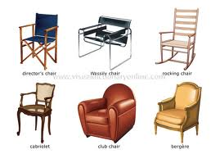
Exemplify
Back to
the start
Giving examples is an excellent way to differentiate.
Examples make something concrete. They make connections between things which are abstract (words, concepts and ideas) and things which have some purchase to them.
Examples can be related to experience, usage and appropriate context.
Whatever type of example you use, you will be helping students to develop their understanding.

Slide 9

Keyword Context
Back to
the start
This links to the previous slide on exemplifying.
Providing context to keywords gives students something to grab hold of. It allows them to situate keywords within a wider framework.
Have a look at the picture to the left. You will notice that the different context surrounding the black circle affects how we see it (both are in fact identical).
Context has the same effect in relation to students’ understanding of keywords.

Slide 10

Antonyms
Back to
the start
Antonyms are opposites:
An antonym of big is small.
An antonym of white is black.
An antonym of fast is slow.
When you introduce students to new words, talk to them about the antonyms of these words.
This will help your students to understand the new words. It will make it clear what the words do not mean (and therefore what it is they do mean).
If possible, use simple antonyms with which students will be readily familiar.

Slide 11
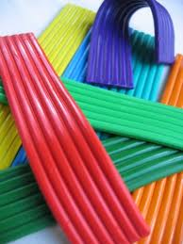
Modelling Conversation
Back to
the start
Engage a student in conversation in front of the whole class. This could be done as part of a whole-class discussion or as part of a question-and-answer session.
Use your conversation to model how to use keywords, technical vocabulary or recently learnt ideas.
You might like to choose a student who you know is already confident with the material to have the conversation with.
Afterwards, set the class off an a discussion task which will involve them using whatever it is you have modelled.

Slide 12

New Words
Back to
the start
Make a wall display to keep track of new words .
Appoint a ‘New-Word Spotter’ who’s job it is to identify when new words appear in the lesson. They should point these new words out and add them to the wall display.
Rotate the role so that a number of students are given an opportunity.
As to the wall display, you could use pieces of card pinned to the wall, a spare whiteboard, a cork board or you could print off the new words and stick them up using Blu-Tack.

Slide 13

Dictionary Champions
Back to
the start
Appoint a number of Dictionary Champions. The role could be rotated on a weekly or a termly basis.
Place some dictionaries at the front of the room.
Every time a new word comes up in class, it is the job of the Dictionary Champions to find out what that word means and to teach it to their peers.
Each Champion should be responsible for a certain number of students. This ensures that all Champions have a chance to teach, and that all students have an opportunity to learn.

Slide 14
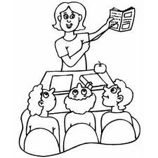
Task Explanation
Back to
the start
Think carefully about how you explain tasks in your lesson. The method I favour is as follows:
Clear, simple instructions on the board.
Pictures where appropriate to accompany instructions.
Verbal explanation accompanied by modelling.
Other options include:
Students who understand what is being asked explain the task to the whole class.
The teacher shows work produced by last year’s students (this will indicate how the end result of the task ought to look).
Provide a checklist either on the board or in a hand-out. Students then work through this, one item at a time.

Slide 15
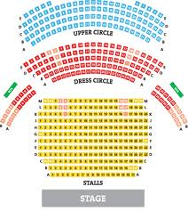
Seating Plans
Back to
the start
Use seating plans to differentiate by:
Placing students of differing abilities next to each other.
Sitting students next to each other where you feel one will have a positive influence on the other.
Setting up the room so that when you go into group work, the groups you want are already sat next to or near each other.
Placing students with certain skills next to students who need to develop those skills.

Slide 16

Hot-Seating
Back to
the start
Hot-seating involves one of two things:
A student comes to the front and answers questions on the topic.
A student comes to the front and answers questions on the topic in character (this being someone related to the area of study).
In both cases, the student is ‘in the hot-seat’.
This is differentiation because the rest of the class can learn from the answers of the students who take on the hot-seat. Also, it allows pupils not in the hot-seat to think up questions to ask. This means everyone can access the task at their own level.

Slide 17

Students Teaching
Back to
the start
Create opportunities for students to take over the teaching. Here are three ways in which this might be done:
Ask a group of students to create a presentation or lesson segment on part of the topic. They then deliver this to the whole class.
Choose students who are particularly knowledgeable about the topic. Pair each of them with a group of their peers and ask them to lead some pre-prepared activities.
If it is appropriate, ask students who have personal experience of a topic to teach the rest of the class about this (for example in Religious Studies).

Slide 18
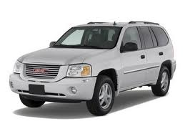
Envoys
Back to
the start
Envoys is an activity in which students all conduct research. Some then go off and teach while the remainder get taught. Here is how it works:
Put the class into groups.
Each group researches a topic.
One person from each group then moves off around the room and teaches the other groups about their topic.
After each group has been taught by each envoy, the envoys return to their original groups.
Here they are informed about everything which their original group has learnt.

Slide 19
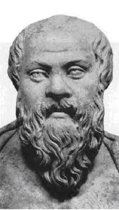
Socratic Dialogue
Back to
the start
Socrates was an philosopher in Ancient Greece. We know about him through the writings of Plato. He used to engage people in philosophical conversation. This involved challenging the arguments that people put forward and the concepts and assumptions on which these were based.
A Socratic dialogue in the classroom involves the teacher talking at length with a pupil about their ideas concerning a topic.
The teacher should ask questions and offer counter-examples. The purpose is to improve the quality of the student’s arguments and to encourage them to look more critically at their ideas.
Doing this with one or two students while the rest of the class listen is a good differentiation technique.

Slide 20

Confidence Indicators
Back to
the start
Ask students to indicate how confident they are with the topic under consideration. Pair up students who are confident with those who are less so.
The teacher can then work with students who are the least confident (and so need the most support).
Here are five ways for students to indicate confidence levels:
Thumbs (up, down, in the middle).
Moving to different parts of the room.
Traffic-light cards (red, orange, green).
On exit passes (make sure they write their names).
By telling you directly (though this takes more time).

Slide 21

Expert Corner
Back to
the start
Ask for a student who feels they are an expert in the topic being studied.
This student is then asked to sit in a corner of the room. They should be given their own table and two chairs (one for them, one for the students who go up to them).
The class is set a task. They are informed that if anyone has any questions or concerns, they should head over to Expert’s Corner for help.
You might develop the activity by having two or three experts in different parts of the room.

Slide 22

Helpers
Back to
the start
If you have students who finish their work before the rest of the class, ask them to stand up, walk round and help other students.
As more students finish, so you can create more helpers.
Eventually, it is likely that you will have about half the class walking round and helping people.
Point out that they can take their work with them if they wish. This should assist them in helping their peers.

Slide 23
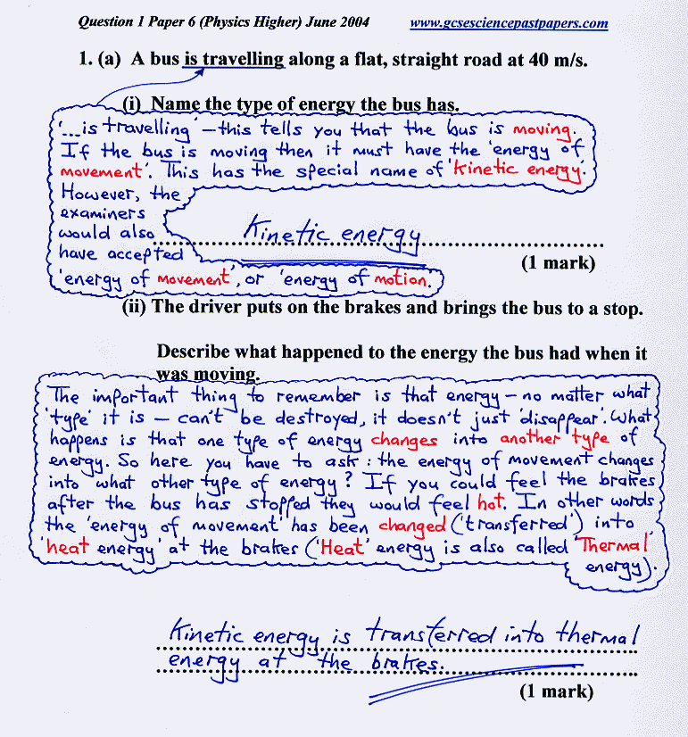
Model Answers
Back to
the start
Present your students with model answers in order to show them what it is that you, or the examiners, are looking for.
The two great benefits of model answers are as follows:
They minimise ambiguity. This is because they demonstrate to students what it is that is being requested by a question or task. This gives students more confidence in what they are doing.
They provide a model! The expectation is not that students will copy, but that they will witness how it is they ought to go about answering.

Slide 24

Photocopy Good Work
Back to
the start
Through the year, photocopy work that students produce which is particularly good.
Keep this work and show it to your future students. The work can act as a guide, a model or a demonstration piece.
You might judge work as being particularly good because:
It is highly creative.
It shows original or innovative thinking.
It achieves high or full marks.
It answers the question or completes the task as was intended.
It is perceptive.

Slide 25

Differentiate by Outcome
Back to
the start
Plan tasks which can be accessed in different ways. This will mean that students can deal with the tasks at a level which they feel they can access (and thus feel happy with).
Such tasks will result in differentiation by outcome.
The model can be summarised as follows:
Create tasks which all students can do, but which are sufficiently open for them to do them to the best of their own ability.
The key is to avoid tasks which demand a very specific response. A final thought would be: ‘Leave space in tasks for students to manoeuvre.’

Slide 26

Open Activities
Back to
the start
Open activities are those in which the teacher sets the guidelines but then leaves it for students to decide how to go about meeting them. Here are some examples:
‘Here is a list of the things you must do. It is up to you how you go about doing them. The only rule is that you must be able to demonstrate your work to me.’
Provides students with a question or statement and ask them to respond in a way they see fit (you might like to provide some ideas in case they get stuck).
Tell students where they should be at the end of the lesson and then invite them to work out their own way of getting there (you will need to provide support to the weakest students).

Slide 27

Prior Knowledge
Back to
the start
Elicit and use students’ prior knowledge.
This will help you to know where students are at. It will also help them to connect your lesson to what they already know.
Try to use and elicit prior knowledge in the starter if possible.
This will help students feel comfortable in the lesson from the beginning. It will also put you in a strong position.
It is good to elicit prior knowledge when you are introducing something new as well. Doing this helps students to contextualise the new information.

Slide 28

Stepped Activities
Back to
the start
Stepped activities take students on a learning journey that gets progressively more challenging.
Plan for your lessons to include tasks which get increasingly complex or which require increasingly sophisticated thinking.
It is not necessary for all students to reach the top of the steps. Encourage them to keep working upwards, but if some reach a point that is causing them problems, let them stop there and work through it.
Stepped activities can be based on Bloom’s Taxonomy of educational activities. See my Bloom-Buster resource for ideas on how to use this.

Slide 29

Options
Back to
the start
Provide students with a range of options as to how they might access a task. For example:
Set students two questions they must answer and then provide them with a range of options to select from:
Write an essay.
Create an extended cartoon strip.
Make a poster advertising your answer.
Write a poem.
Come up with a short drama piece.
Draft a speech in which you put forward your point of view.
Create a song inspired by one of the questions.

Slide 30

Choices
Back to
the start
Give students a range of questions or tasks and ask them to pick which ones they will deal with and in which order.
The questions and tasks should be of varying levels of difficulty.
Decide in advance if you want to order them according to their difficulty level.
If you do, it will make it easier for students to judge which are harder and which are easier. This could be beneficial to your pupils, or it might lead them to make choices which are below what they are capable of doing.

Slide 31

Extensions
Back to
the start
Have extension questions or tasks ready for pupils who complete the work.
My preferred option is to have extension questions on all my PowerPoint slides.
In addition, I create super-extensions, hyper-extensions and even outer-space-extensions for students who finish these.
Use the higher levels of Bloom’s Taxonomy to create your extension questions and tasks.
You can also call on philosophy, in particular by asking students to analyse concepts.

Slide 32

Wonder Wall
Back to
the start
I have borrowed this technique from my friend James Wright. My interpretation of it is as follows:
Create a space on your classroom wall called the ‘Wonder Wall’. You might like to make this look like a wall by chalking bricks onto black paper.
When students think of questions and there is not enough time to explore these, ask them to write them down on a Post-It® note and to stick this on the Wonder Wall.
When students have finished the tasks you have set in a lesson, ask them to fetch a question from the ‘Wonder Wall’ and to explore it either with a partner or in writing.

Slide 33

Group Work
Back to
the start
Group work allows students to talk with one another and to share their understanding of the topic.
In turn, it can allow all members of a group the chance to develop their understanding. This comes through the discussion group work involves and the working-together which it entails.
Think carefully about the make-up of your groups. Mixed-ability is often best.
You may also likely to allocate roles to members of the groups so as to ensure that everybody knows what is expected of them.

Slide 34

Pair Work
Back to
the start
Pair work allows students to discuss a question or task. This helps them to develop their understanding.
You might like to pair stronger and weaker students so that the former can help the latter to access what they might find difficult on their own.
Alternatively, you might want to pair two weaker students so that you can then work with them yourself. This will allow you to help them both make good progress.

Slide 35

Discussion
Back to
the start
Discussion helps students in the following ways (among others):
It allows them to explore a topic or an idea and to hear what others think.
It lets them articulate their own thoughts. This, in turn, helps them to form and refine those thoughts.
It gives them space in which to make mistakes and to clarify meaning – this is harder to do in writing.
It allows them to make use of a skill which they most are likely to be highly competent in (talking). This is less likely to be the case with writing.
It is an excellent precursor to writing, allowing students to prepare and develop their thoughts before committing them to paper.

Slide 36

Personal Experience
Back to
the start
Here are three ways in which you can use students’ personal experience to help them to learn:
Build tasks and questions into your lessons which ask students to call on their own experience.
Demonstrate how topics covered in your lessons relate to people’s everyday experiences.
Try to find out about the experiences of your pupils. If appropriate, call on these when you are teaching. You may well be able to use them in order to make points clearer and more relevant for your students.

Slide 37

Pace Yourself
Back to
the start
Where possible, set up lessons or segments of lessons in which students are able to go at their own pace. Here are some ways of doing this:
Make use of extensions, stepped activities, options, choices and open activities (all of which are explained in this PowerPoint).
Create a series of hand-outs which students are to work through. When they have finished one, they come and collect the next one from you.
Give students a list of things they must do, a list of things they should try to do and a list of things that are ‘extras’. Let them work through the lists at their own pace.

Slide 38
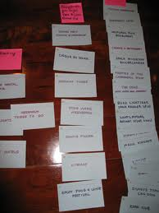
Card Sorts
Back to
the start
A card sort is a good activity because it allows students to sort, order and match information.
It is accessible because the information is visible and can be physically manipulated. Some students will find the parallel cognitive processes hard to cope with if they do not have something tangible to support them.
A good tip is to create hardy card sorts by using a top and a bottom bit of card for each piece. This means they are less likely to get damaged and there is a better chance that you will be able to use the same ones year-after-year.

Slide 39

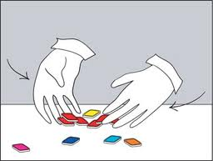

Matching, Grouping and Ranking
Back to
the start
Matching, grouping and ranking activities are good because they are accessible to all students.
At the same time, they invite different levels of thought. For example, a high-ability student may be able to give a detailed argument explaining their ranking of a set of items, while a lower-ability student may choose instead to refer to experience and comparisons.
The three activity types also invite a close examination of ideas and items through a concrete process. That is because the matching, grouping and ranking will either involve physical materials such as cards, or the writing down and rearranging of words.

Slide 40
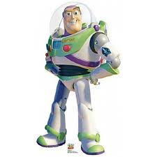
Buzz Groups
Back to
the start
Buzz groups are simply small groups of two or three students formed impromptu to discuss a topic for a short period. In a pair it is almost impossible for a student to stay silent and once students have spoken "in private" they are much more likely to speak afterwards "in public" in the whole group.
Buzz groups are very useful to get things going. The sound of ten pairs buzzing is quite energising compared with one person speaking in a group of 20.
Buzzes can also tune students in to your subject matter and wind up their ideas; for example:
"To start off, let's buzz for five minutes on what your initial reactions were to the readings I set for this week's seminar. Off you go.“
Taken from - http://www.brookes.ac.uk/services/ocsd/teachingnews/archive/autumn04/tips_buzz.html

Slide 41

Design Brief
Back to
the start
Provide students with a design brief which they are to fulfil in whatever way they think is best.
This need not be restricted to design-led lessons.
For example, you might set the following design brief in a History lesson:
‘Create something which coveys the various responses throughout Europe to French Imperialism under Napoleon.
Ensure you consider both the immediate and the longer-term responses as well as what actions, if any, these led to.’

Slide 42
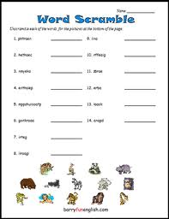
Worksheets
Back to
the start
Here are five ways you can use worksheets to differentiate:
Create a variety of worksheets in advance of the lesson. These should be aimed at various ability-levels in your class.
Use a number of worksheets akin to the model outline din the ‘Pace Yourself’ entry.
Create a range of worksheets which gradually increase in difficulty. Students then work their way through these, getting as far as they can.
Create worksheets which include open questions or tasks.
Create worksheets which provide students with various options or choices (see the ‘Options’ and ‘Choices’ slides).

Slide 43
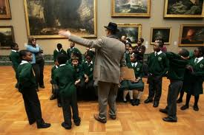
Visits and Visitors
Back to
the start
Visits and visitors are a great way of differentiating. They are engaging for students for the following reasons:
They are interactive.
They are unusual.
They are a change to the routine.
They bring learning alive.
They are different to most of what goes on in the classroom.
It is a good idea to plan work around a visit or visitor. This means:
You can prepare students so as to ensure they get the most out of it.
You can capture their learning afterwards and build on this.

Slide 44
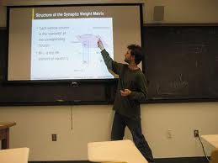
Student Presentations
Back to
the start
Divide the class into groups.
Give each group a topic to research or a question to answer.
Provide appropriate resources and ask the groups to create a presentation they will give to the whole class.
To avoid boring presentations, set students some ground rules. For example:
No reading off slides.
Make a hand-out.
Include one piece of drama.
Include one game or interactive element.
Include one discussion question (and then lead the discussion).

Slide 45

Case Studies
Back to
the start
Case studies are a good method to use because they contextualise ideas and provide students with concrete example they can use to situate abstract concepts.
In essence, case studies provide evidence of concepts, categories and ideas at play in the real world.
They demonstrate what you are teaching about as it is lived.
Many textbooks and educational websites provide ready-made case studies. You can also use newspaper articles. If you cannot find what you want, create your own. You will be able to re-use it year-after-year.

Slide 46
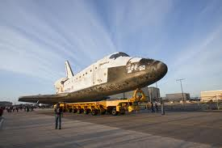
Discovery Learning
Back to
the start
‘Discovery Learning is a method of inquiry-based instruction, discovery learning believes that it is best for learners to discover facts and relationships for themselves.’
Taken from - http://www.learning-theories.com/discovery-learning-bruner.html
You can build discovery learning into your lessons through:
Group work.
Providing some of the information and letting students work out the rest.
Setting students independent tasks such as research or a design brief.
Experiments.
Investigations.

Slide 47
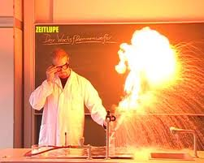
Experiments
Back to
the start
Experiments have a number of benefits:
They are practical, meaning they are accessible.
They often involve discovery learning (see the previous slide).
They can be exciting and engaging.
They give students the opportunity to lead their own learning.
They promote reasoning and use of the scientific method.

Slide 48
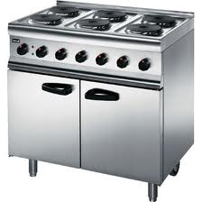
Question Range
Back to
the start
Use a range of questions in your lessons so as to take account of the different places your students are at as regards their learning. Questions might be:
Abstract or concrete.
Leading or non-leading.
Personal or impersonal.
General or specific.
Closely connected to the learning or more tenuous.
There are other options as well, many of which are considered in the next few slides.

Slide 49

Question Planning
Back to
the start
Plan your questions in advance. The advantage of this is that you can set up a range of different questions which are specific to the topic and to your students.
You might like to keep a note of your questions so that you can use them when you teach the topic again.
If you feel you do not have time to plan questions, make use of categories and question types.
You can call on these during a lesson and create questions based on them. This will stop you falling back onto questions you have used previously or which do not move learning forwards. See other slides in this PowerPoint for useful question types and categories.

Slide 50
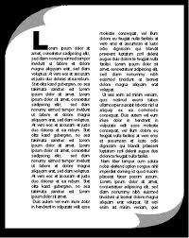
Justify
Back to
the start
Ask students to justify the claims they make.
You might like to give them an opportunity to discuss this with their partner before they tell you. It is likely this will make the process easier for them.
All students can justify their claims. The difference comes in the sophistication of these justifications.
By encouraging students to justify what they say you are encouraging them to reason. This is integral to all learning.

Slide 51

Open and Closed
Back to
the start
Think carefully about when to use open and closed questions.
As a rule I would generally favour open questions. This is because they allow students the opportunity to reason, to advance positions, to make claims and to think carefully about a topic.
Closed questions are more likely to see students attempting to guess the correct answer.
Use the word ‘might’ to open up your questions:
What is democracy?
What might democracy be?
Clearly there is greater scope for thinking and discussion in the second case then there is in the first.

Slide 52

Clarification
Back to
the start
Ask students clarifying questions.
Encourage them to do the same to you.
The great advantage of clarifying questions is that they diminish ambiguity. This is because they require the person being questioned to explain an aspect of their thought or speech so that it is clear to the questioner.
Questions of clarification include:
What exactly do you mean by that?
Can you give me an example?
How would that work?
Can you explain that again?
What would you compare it to?

Slide 53
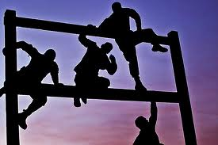
Challenging Questions
Back to
the start
Use challenging questions to stretch the most able students in your class. Here are some types of question you might call upon:
Evaluative questions (judge, assess, critique, defend).
Creative questions (plan, unite, merge, create).
Comparison questions (how does it compare? How is it different? To what is it similar and why?).
Big questions (philosophical, ‘what if’ scenarios, values-based questions).
Exam-style questions.

Slide 54

Students Ask Questions
Back to
the start
Encourage your students to ask questions. There are many benefits to this, including:
Students can ask questions at the level with which they are comfortable.
Students can hear other people’s questions.
Students can observe how the teacher goes about answering questions.
The teacher can find out what areas students want to know about.
Students can find out information from the teacher’s responses.

Slide 55
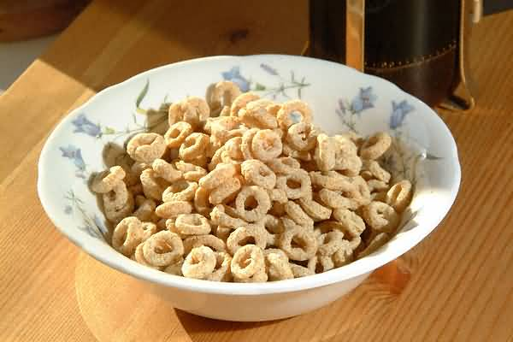
Serial Questioning
Back to
the start
Plan a series of questions which you will ask to the class as a whole or to individual students.
The purpose of this is to create a structure in which the questions:
Get progressively more challenging.
Take students on a journey around different parts of their thinking.
Encourage students to think about something in a variety of different ways.
By having a series of questions pre-prepared, you will be better placed to draw students in and to guide their learning in certain directions.

Slide 56

Thinking Time
Back to
the start
Ask a question.
Then…
…Wait.
This let’s students think. It gives them time to come up with an answer. It allows all students to access the question. And it let’s more able students develop their responses.

Slide 57

Individual Questioning
Back to
the start
If you go and spend time with individual students then you are differentiating.
Even better is if you ask different individuals different questions.
These should take account of what those students know, where they are at and what your experience of them is.
In essence:
Create opportunities where you can go and work with individual students.
Tailor your questioning to the student with whom you are working.
Respond to what they say with further questions.

Slide 58
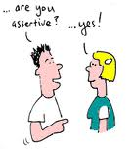
Assertive Questioning
Back to
the start
Don’t wait for students to put their hands up.
This will inevitably lead to the students who are most confident (whether rightly or not) dominating discussion.
Instead, be assertive.
Decide who you want to hear from and then ask them. This could be in a whole-class situation or when students are working in pairs or in groups.
Think about your purpose beforehand. Is it:
To move the learning on?
To root out misconceptions?
To encourage reasoning?
Or is it something else? Use this to guide your questioning and your choice of who to question.

Slide 59

Task Mixture
Back to
the start
Use a mixture of tasks. This will ensure that students have a variety of opportunities. It will prevent students from feeling that ‘we only do things one way’ (and if you do, that could be a way that some students find really difficult to access).
You can use a mixture of tasks:
In a single lesson.
Across a unit of work.
Across the year as a whole.
You might like to develop a collection of task-types with which you feel comfortable and stick to these.
Or, you might use the opportunity to test out different approaches.

Slide 60
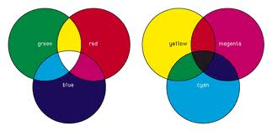
Task Mixture II
Back to
the start
An alternative way to judge whether you have a mixture of tasks is to look at what you are asking students to produce.
This is a little like working backwards.
When planning a lesson or a unit of work, identify a mixture of products you would like students to have created by the end of it.
Base your activities on this list and they cannot fail to be a mixture. This is because they will be driven by the list of different products. You will have no choice but to use a range of activities in order to ensure these are created.

Slide 61

Blooming Extensions
Back to
the start
Use Bloom’s Taxonomy to create extension questions and tasks. Here are a list of words linked to the top three levels:
Analysis: Analyse, Appraise, Categorize, Compare, Contrast, Differentiate, Discriminate, Distinguish, Examine, Experiment, Explore, Investigate, Question, Research, Test.
Synthesis: Combine, Compose, Construct,
Create, Devise, Design Formulate, Hypothesise, Integrate, Merge, Organise, Plan, Propose, Synthesise, Unite.
Evaluate: Appraise, Argue, Assess, Critique, Defend, Evaluate, Examine, Grade,
Inspect, Judge, Justify, Rank, Rate,
Review, Value.

Slide 62


Evaluate and Create
Back to
the start
When setting extension tasks and extension questions, focus on asking students to evaluate and create.
These are the highest level skills in Bloom’s Taxonomy and they require the greatest degree of mastery over the material being studied.
In addition, when you are planning to include stepped activities or a mixture of tasks (see slides in this PowerPoint), use evaluate and create based activities as the end-points of the lesson.
Making these that which everything else is building up to will ensure the level of challenge gets progressively higher as the lesson progresses.

Slide 63

Blooming Questions
Back to
the start
Use Bloom’s Taxonomy to inform questioning throughout your lessons.
Here are a list of words linked to all six levels:
Knowledge: Arrange, Define, Describe, List, Match, Memorise, Name, Order, Quote, Recognise, Recall, Repeat Reproduce, Restate, Retain.
Comprehension: Characterise, Classify, Complete, Describe, Discuss, Establish, explain, Express, Identify, Illustrate, Recognise, Report, Relate, Sort, Translate.
Application: Apply, Calculate, Choose, Demonstrate, Dramatise, Employ, Implement, Interpret, Operate, Perform, Practise, Role-Play, Sketch, Solve, Suggest.
Analysis: Analyse, Appraise, Categorize, Compare, Contrast, Differentiate, Discriminate, Distinguish, Examine, Experiment, Explore, Investigate, Question, Research, Test.
Synthesis: Combine, Compose, Construct,
Create, Devise, Design Formulate, Hypothesise, Integrate, Merge, Organise, Plan, Propose, Synthesise, Unite.
Evaluate: Appraise, Argue, Assess, Critique, Defend, Evaluate, Examine, Grade,
Inspect, Judge, Justify, Rank, Rate,
Review, Value.

Slide 64
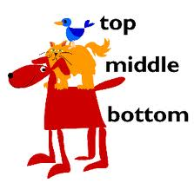
Top, Middle and Bottom
Back to
the start
When teaching mixed-ability classes we often teach to the ‘middle’.
To some extent this is inevitable. It is the safest position for ensuring that most of the students get what we are talking about.
It can be good to mix this up though. Try to teach to the ‘bottom’ and the ‘top’ at least a couple of a times a lesson.
Make a conscious effort to do this.
You might preface it by saying, ‘This might seem obvious but I just want to make it clear for you,’ or, ‘This next bit is a bit complicated, but stick with it, it’ll be worth it.’

Slide 65

AFL
Back to
the start
Use assessment for learning to differentiate.
By identifying where your students are at and what they need to do to close the gap, you will be differentiating.
Elicit information about learning and use this to inform your planning.
Make good use of self- and peer-assessment.
For AFL ideas, see some of my other resources:
http://www.tes.co.uk/teaching-resource/Assessment-For-Learning-Toolkit-6020165/
http://www.tes.co.uk/teaching-resource/Peer-and-Self-Assessment-Guide-6024930/
http://www.tes.co.uk/teaching-resource/The-Whole-Class-Feedback-Guide-6057595/

Slide 66

Listening Frame
Back to
the start
Create a listening frame for students who struggle to make notes.
This could be a worksheet with a set of sections on it, each one headed by a question, statement or category.
The student can then use this to make notes. The sections will help them to order the information they receive. This will eliminate a thinking process for them, thus allowing them to concentrate exclusively on listening and writing.
In essence, a listening frame does a bit of the work for the student, making life easier for them.

Slide 67
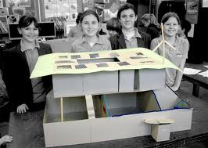
Modelling
Back to
the start
Modelling is where the teacher demonstrates to the class, or to individual students, what it is they want them to do.
Modelling could be physical. For example, you might walk through the steps involved in an envoys task.
Modelling could be written. For example, you might show students how you want them to create a table and what sort of things they are to write in it.
Modelling could be oral. For example, you might have a model discussion with a pupil and then ask the class to get into pairs and have their own discussions.

Slide 68

Check Sheets
Back to
the start
Provide students with check sheets for tasks. This gives them something they can refer back to as they progress. It is a means for them to keep track of where they are at and to know what they still have to do.
A particularly good use of check sheets is when students are doing written work.
In this case, the check sheet will help students to keep track of what they have done and where they are going, but it will also act as a tacit guide demonstrating how they should structure their work.

Slide 69

Structure Guidelines
Back to
the start
You can provide students with explicit structure guidelines to help them with written work. Here is an example of an essay guide:
Paragraph 1 – Introduction
P.2 – First argument for
P.3 – Second argument for
P.4 – First argument against
P.5 – Second argument against
P.6 – Conclusion
Structure guidelines can be general or specific. You will need to judge what is most appropriate for your students.

Slide 70

Sentence Starters
Back to
the start
Sentence starters are a great way to get students going. Here are five ways you might use them:
Write them on your PowerPoint or IWB slides.
Have generic ones stuck up around the room.
Produce a sheet or booklet of sentence starters for students who struggle to get going with their writing.
Create a couple of sentence starters with your class before starting the activity.
Ask a couple of students who have started writing to read out the beginnings of their sentences.

Slide 71

Writing Frame
Back to
the start
A writing frame is like a listening frame (see a few slides previous) in that it does some of the work for the student.
This allows them to concentrate their energies on one task – the writing itself.
Writing frames can be highly structured, giving sentence starters or indications of content for every separate section.
Alternatively, they can be more akin to structure guidelines.
You can make some generic writing frames for particular genres (essays, reports, summaries etc.) and use these across lessons and Key Stages.

Slide 72

Planning Pro-Forma
Back to
the start
A planning pro-forma is a document you hand out to students and which they use to help plan their work.
You might have a range of pro-forma to cover writing tasks, group work, research tasks and so on.
The level of detail in your pro-forma will be dependent on how much support you feel your students need.
It may be the case that with some students you provide detailed guidelines for them to follow and just ask them to make choices from a set of options you indicate.

Slide 73

Scrap Paper
Back to
the start
Scrap paper is a thinking tool.
It is an extension of our memory.
By writing something on a scrap piece of paper we do not have to hold it in our head.
We can therefore manipulate it more easily and free up our short-term memory for other things.
Encourage students to use scrap paper.
Demonstrate its use to them and explain why and how it works.

Slide 74

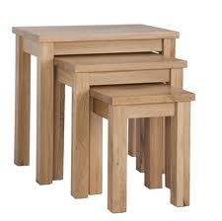
Bullet Points and Tables
Back to
the start
Bullet points and tables are different ways of organising information. They present material in ways that many students may find easier to deal with.
You will notice that I have used bullet points a lot through this document in order to simplify.
Tables allow one to divide material simply into two or more categories.
A good strategy is to use bullet points and tables as precursors to more extended writing.

Slide 75

Individual Writing
Back to
the start
Individual writing tasks are differentiated because each student can access the task in their own way.
Use some of the techniques and strategies explained in this document to support students when they are doing such a task.
Try to ensure that you precede individual writing tasks with an activity that feeds in. This will make it easier for students to begin writing. They will already have had an opportunity to think about the topic and to begin ordering their thoughts.

Slide 76

Challenge
Back to
the start
Stretch and challenge your students by using my challenge toolkit:
http://www.tes.co.uk/teaching-resource/Challenge-Toolkit-6063318/

Slide 77

Different Media
Back to
the start
By using a range of different media in your lessons, or across a unit of work, you will be differentiating.
The range of material will ensure that students are kept engaged and that there are different opportunities for accessing the content.
Media include:
Videos
Songs
Animations
Computer games
Newspaper articles
Stories
Hand-outs
Slides

Slide 78
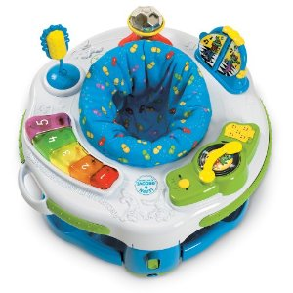
Activity Stations
Back to
the start
Activity stations works as follows:
Set up a number of different stations around the room.
Each station should have a different resource and/or task attached to it.
Ensure that there are a variety of types of resource and task. For example: you might have a case study, a laptop with a video on it, a card sort, a hand-out, a diamond nine and a newspaper article.
Put students in groups and assign each group to a station.
Rotate the groups after a set length of time. Aim for each group to visit each station.

Slide 79

Narrative
Back to
the start
Stories help us make sense of the world. They provide a way of dealing with complex ideas which is more accessible than non-narrative prose.
Use stories in your lessons to help students access the content.
You might also like to create tasks in which students write their own stories, based on some aspect of what you have been studying.

Slide 80
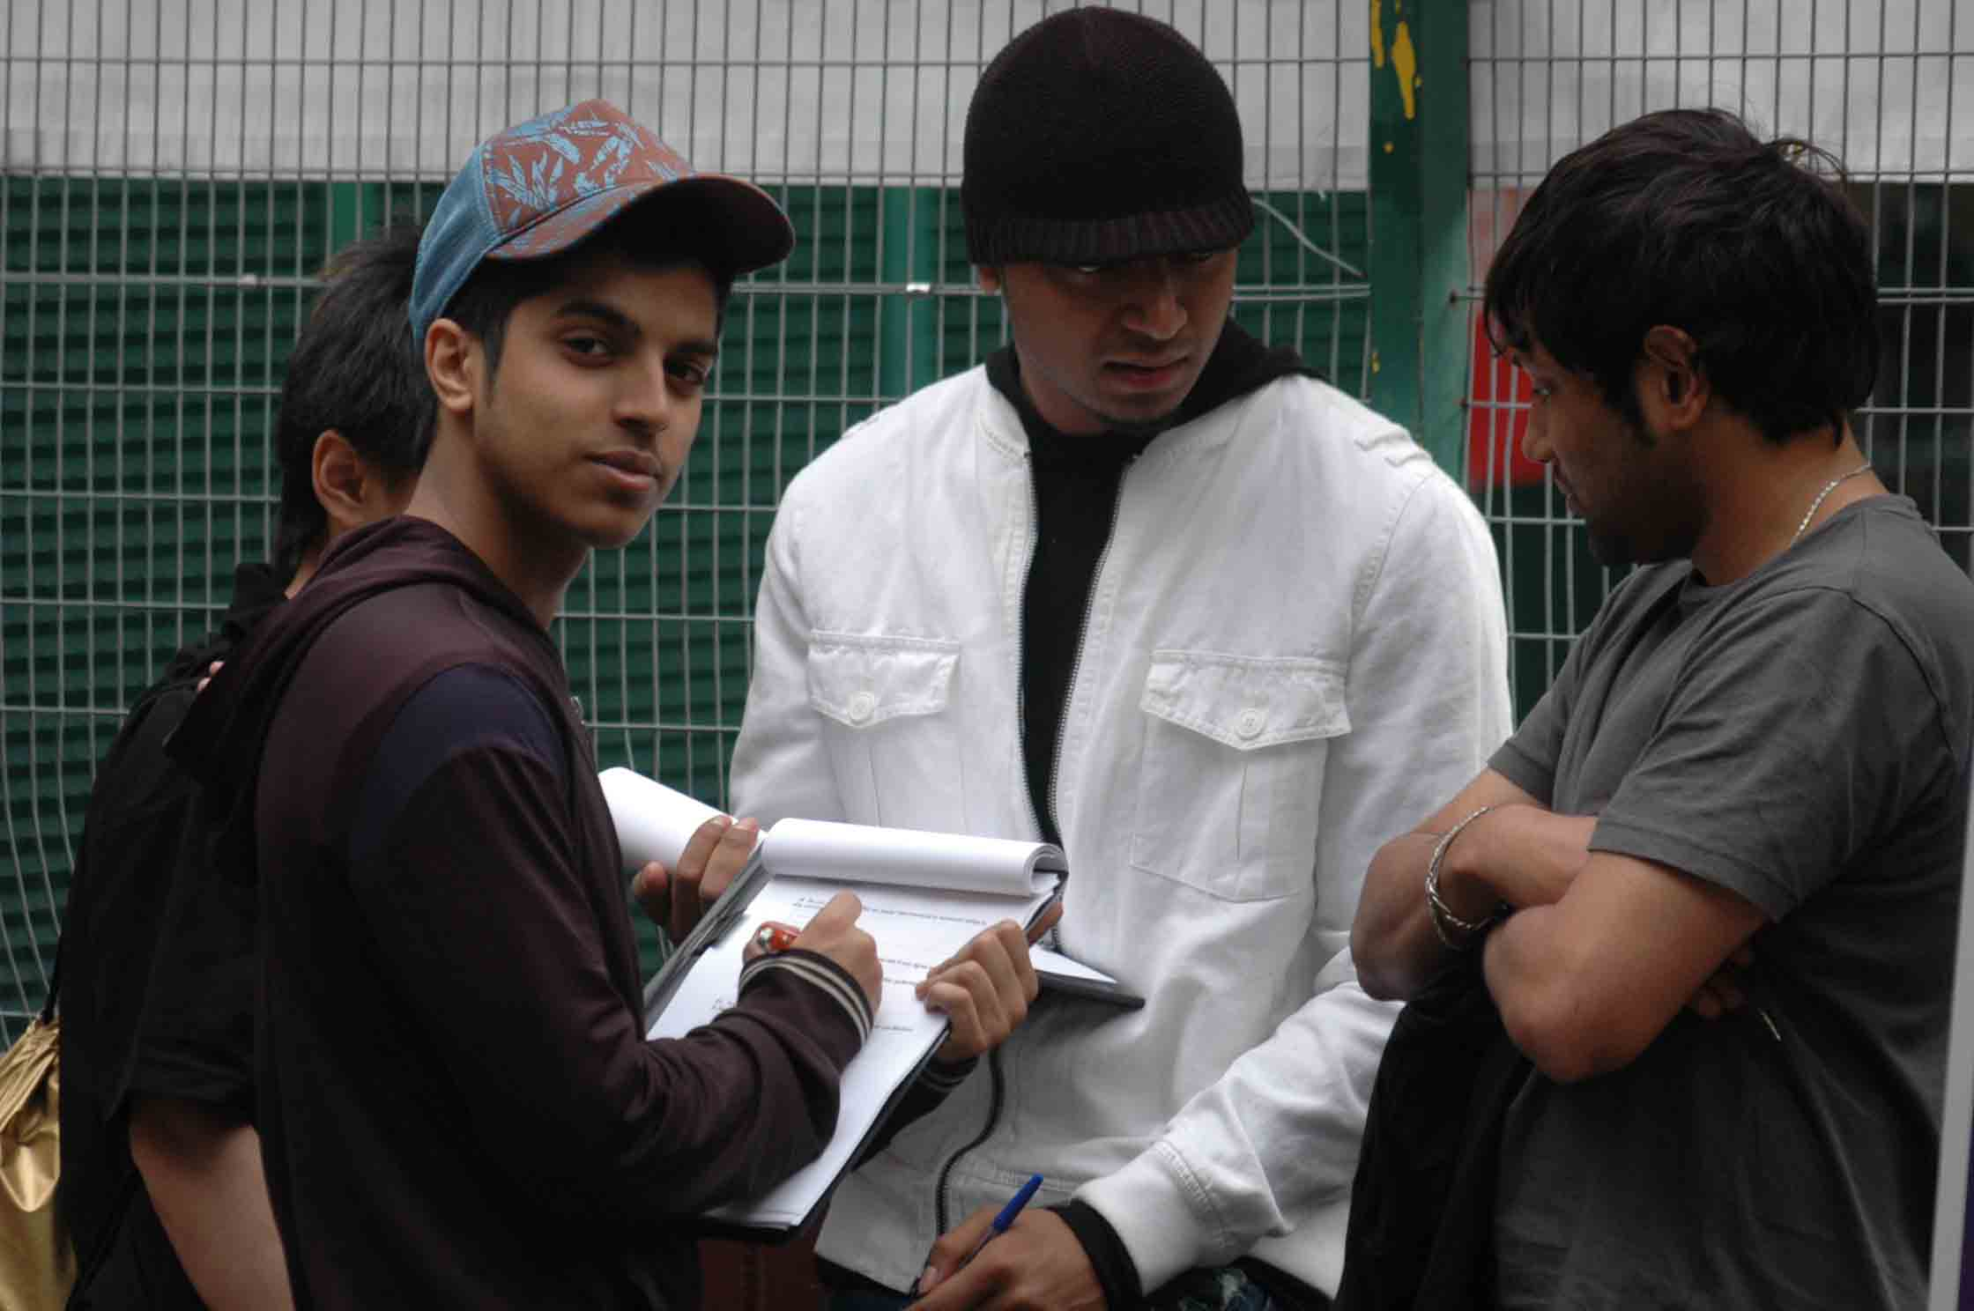
Peer Research
Back to
the start
Here is how peer research works:
Introduce students to a topic.
Explain that they will be researching the views and experiences of their peers.
Ask them to create a set of questions they can ask people about the topic. I have found that between 5 and 10 is best, depending on time constraints.
Invite students to interview each other using their questions.
When finished, students should write up their results.

Slide 81

Talk To Me
Back to
the start
Set out with the aim of talking to as many students as possible during a lesson.
By doing this, it is likely that you will be able to ascertain where most of them are at in relation to the learning.
In turn, you will be able to support and assist those who are struggling.
It will not always be possible to talk to lots of students. Particularly if you have a difficult class who need to be watched.
If this is the case, aim to do it once every few lessons. Alternatively, call students up to the front to talk to you. Make a note of who comes up and try to get through the whole class over a few lessons.

Slide 82

Humour
Back to
the start
Humour is a great way of motivating and engaging students as well as making all of them feel involved and included in the lesson.
Look for opportunities to use humour.
Search the web for jokes, even if they are bad ones, and don’t be afraid to laugh at yourself as well.

